Slide 1
Overview of UX – UI design

Slide 2
What’s on the menu?
Who’s who?
Program and timeline
Methodologies
Q/A

Slide 3
Who’s who
Helloooo!
Nice to meet
You !

Slide 4
Program and timeline
Name of the lesson | Number of hours
Introduction to UX | 3.5
Principles of design and ergonomics | 17.5
Information Architecture | 7
Design system & Prototyping | 7
User testing | 3.5
Design thinking | 3.5
Accessibility | 3.5
Metrics | 3.5
Project | 21

Slide 5
Introduction to UX
Objectives – Explore the fundamentals of User Experience (UX) and User Interface (UI) design.
UX focuses on understanding users and crafting digital experiences that are intuitive and satisfying, while UI shapes the visual and interactive elements—like layout, color, and navigation.
Great UX/UI design starts with research, evolves through prototyping, and improves through testing—always keeping the user at the center.
Benefits, Key differences (UX vs UI), Job description and… introduction to final project.

Slide 6
Principles of design and ergonomics
Objectives – Explore the essential principles that drive intuitive and effective user experiences.
Design decisions impact usability, and visual structure, consistency, and user feedback shape the way people interact with digital products.
Apply core design principles (alignment, hierarchy, contrast, proximity)
Evaluate interfaces using usability heuristics
Reduce cognitive load and improve navigation flow
Design with accessibility and inclusivity in mind
Create user-friendly, responsive layouts that enhance the user journey

Slide 7
Principles of design and ergonomics
A lot of design principles (contrast, repetition, alignment, proximity…)
Psychology Principles and Laws, Gestalt Principles
Heuristics
The 8 Bastien & Scapin Criteria

Slide 8
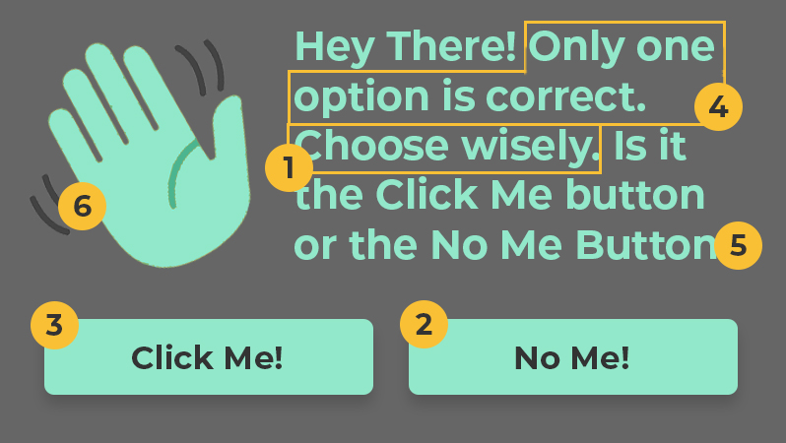
Example of an exercise - 1
Let’s assess where emphasis could be applied or reduced to improve the design
Source: https://uxengineer.com
Notes:
The call-to-action will be to “Choose Wisely,” making it immediately clear what the user should do.
The primary button will be the “No Me” button. We’ll make this the second most emphasized element, so the user can can have confidence that it’s the “right choice.”
The secondary button will be the “Click Me” button. This button will have less emphasize to make it clear that it’s not as important as the primary button.
Next, we’ll make sure the reader knows “only one option is correct” by giving it more emphasis than the remaining text.
The remaining text is merely provided for more context. Since it’s not as important as the previous elements it will be toned down a bit.
Finally, the waving hand icon is the least important element. If anything, it only serves to help communicate the message subconsciously. Therefore, it will be muted to fade into the background.

Slide 9
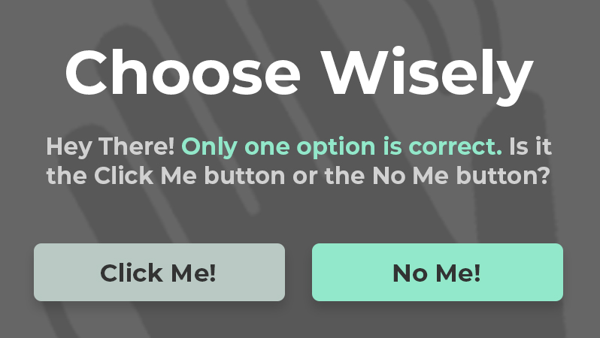
Example of an exercise - 1
A proposal
Source: https://uxengineer.com

Slide 10

Example of an exercise – 2 01. Guidance / Readability
Choose a web interface and assess it.
You can use capian.co as audit tool.
Is the user assisted in how to use the interface?
Is information of the same nature grouped together?
Does the interface provide regular feedback to users?
Are the affordances clear and visible?
Are the available actions clearly visible?
If needed, does the user have access to help?
Source: http://pixabay.com

Slide 11
Information Architecture
Objectives – Explore the fundamentals of Information Architecture (IA)— the practice of organizing, structuring, and labeling content in a clear and meaningful way.
Key IA elements :
User flows and task paths
Sitemaps and navigation menus
Content hierarchy and categorization
Labeling systems and taxonomy
A solid IA improves usability, reduces user frustration, and enhances the overall experience by making digital products easier to understand and navigate.

Slide 12
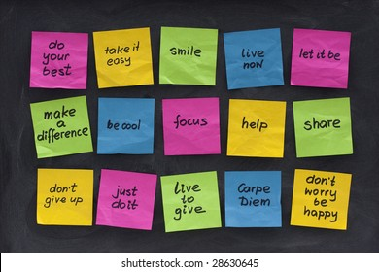
Example of an exercise – Step by step Taxonomy & Classification
Let’s create a taxonomy for a DIY service included in the website of a store using the Post-it method.
The goal is to define clear categories and subcategories to help users navigate the site easily.
Source: https://www.tomazlaven.se/ordsprak-visdomsord-och-citat-om-livet/
Notes:
The final project is: CraftEase is a web application solution developed for home improvement retailers who want to enhance customer engagement directly through their website.
Our goal is to provide your store with an integrated digital service that helps manage DIY workshop registrations, promote project tutorials, and track tool/material availability in real time.
The platform is designed to be seamlessly embedded into your existing website. It is user-friendly, secure, and adaptable to your branding and customer needs. Features include personalized project recommendations, booking management, customer feedback tools, and analytics for store teams.

Slide 13
Example of an exercise – Step by step Taxonomy & Classification
Brainstorm Content
Instruction:
Write one topic per Post-it (e.g., “Material“, “Workshops“, “Videos").
Think about subjects, formats, user needs, and types of content.
Stick them randomly on the board.
Notes:
Step 1: Brainstorm Content (10 min)
🗒️ Instruction:
Write one topic per Post-it (e.g., "Math," "Online Courses," "Teen Learning").
Think about subjects, formats, user needs, and types of content.
Stick them randomly on the board.
Step 2: Group Similar Ideas (15 min)
🗂️ Instruction:
As a group, organize similar Post-its into clusters.
Look for patterns and common themes.
Don’t force a category yet—just group logically.
Step 3: Define Main Categories (15 min)
🔠 Instruction:
Identify 4-6 broad categories from your groups.
Write category names on new Post-its and place them at the top.
Example: Subjects, Learning Levels, Formats, Certifications.
Step 4: Refine Subcategories (15 min)
📌 Instruction:
Place specific Post-its under the most relevant main category.
Merge, rename, or refine as needed.
Example: Subjects → Science → Biology, Chemistry, Physics.
Step 5: Validate & Adjust (15 min)
✅ Instruction:
Ask yourself:
"Where would I find an Intro to Biology course?"
"How do I browse all Certified Courses?"
Adjust if anything is unclear or misplaced.

Slide 14
Example of an exercise – Step by step Taxonomy & Classification
Group Similar Ideas
Instruction:
As a group, organize similar Post-its into clusters.
Look for patterns and common themes.
Don’t force a category yet—just group logically.
Notes:
Step 1: Brainstorm Content (10 min)
🗒️ Instruction:
Write one topic per Post-it (e.g., "Math," "Online Courses," "Teen Learning").
Think about subjects, formats, user needs, and types of content.
Stick them randomly on the board.
Step 2: Group Similar Ideas (15 min)
🗂️ Instruction:
As a group, organize similar Post-its into clusters.
Look for patterns and common themes.
Don’t force a category yet—just group logically.
Step 3: Define Main Categories (15 min)
🔠 Instruction:
Identify 4-6 broad categories from your groups.
Write category names on new Post-its and place them at the top.
Example: Subjects, Learning Levels, Formats, Certifications.
Step 4: Refine Subcategories (15 min)
📌 Instruction:
Place specific Post-its under the most relevant main category.
Merge, rename, or refine as needed.
Example: Subjects → Science → Biology, Chemistry, Physics.
Step 5: Validate & Adjust (15 min)
✅ Instruction:
Ask yourself:
"Where would I find an Intro to Biology course?"
"How do I browse all Certified Courses?"
Adjust if anything is unclear or misplaced.

Slide 15
Example of an exercise – Step by step Taxonomy & Classification
Define Main Categories
Instruction:
Identify 4-6 broad categories from your groups.
Write category names on new Post-its and place them at the top.

Slide 16
Example of an exercise – Step by step Taxonomy & Classification
Refine Subcategories - Group and label the content
Instruction:
Place specific Post-its under the most relevant main category.
Merge, rename, or refine as needed.

Slide 17
Design system & Prototyping
Prototyping is at the heart of UX design — it’s where ideas take shape, get tested, and evolve. By creating interactive representations of a product early in the process, designers can experiment, validate assumptions, and align teams before costly development begins.
In addition, this module introduces the fundamentals of Design Systems, showing how reusable components, design tokens, and shared guidelines ensure consistency and scalability when transitioning from prototype to production.
In this module, participants will learn how to:
Turn concepts into tangible experiences, using low- and high-fidelity prototypes.
Communicate design intent clearly to stakeholders and developers through interactive flows.
Iterate efficiently by integrating user feedback and test results.

Slide 18
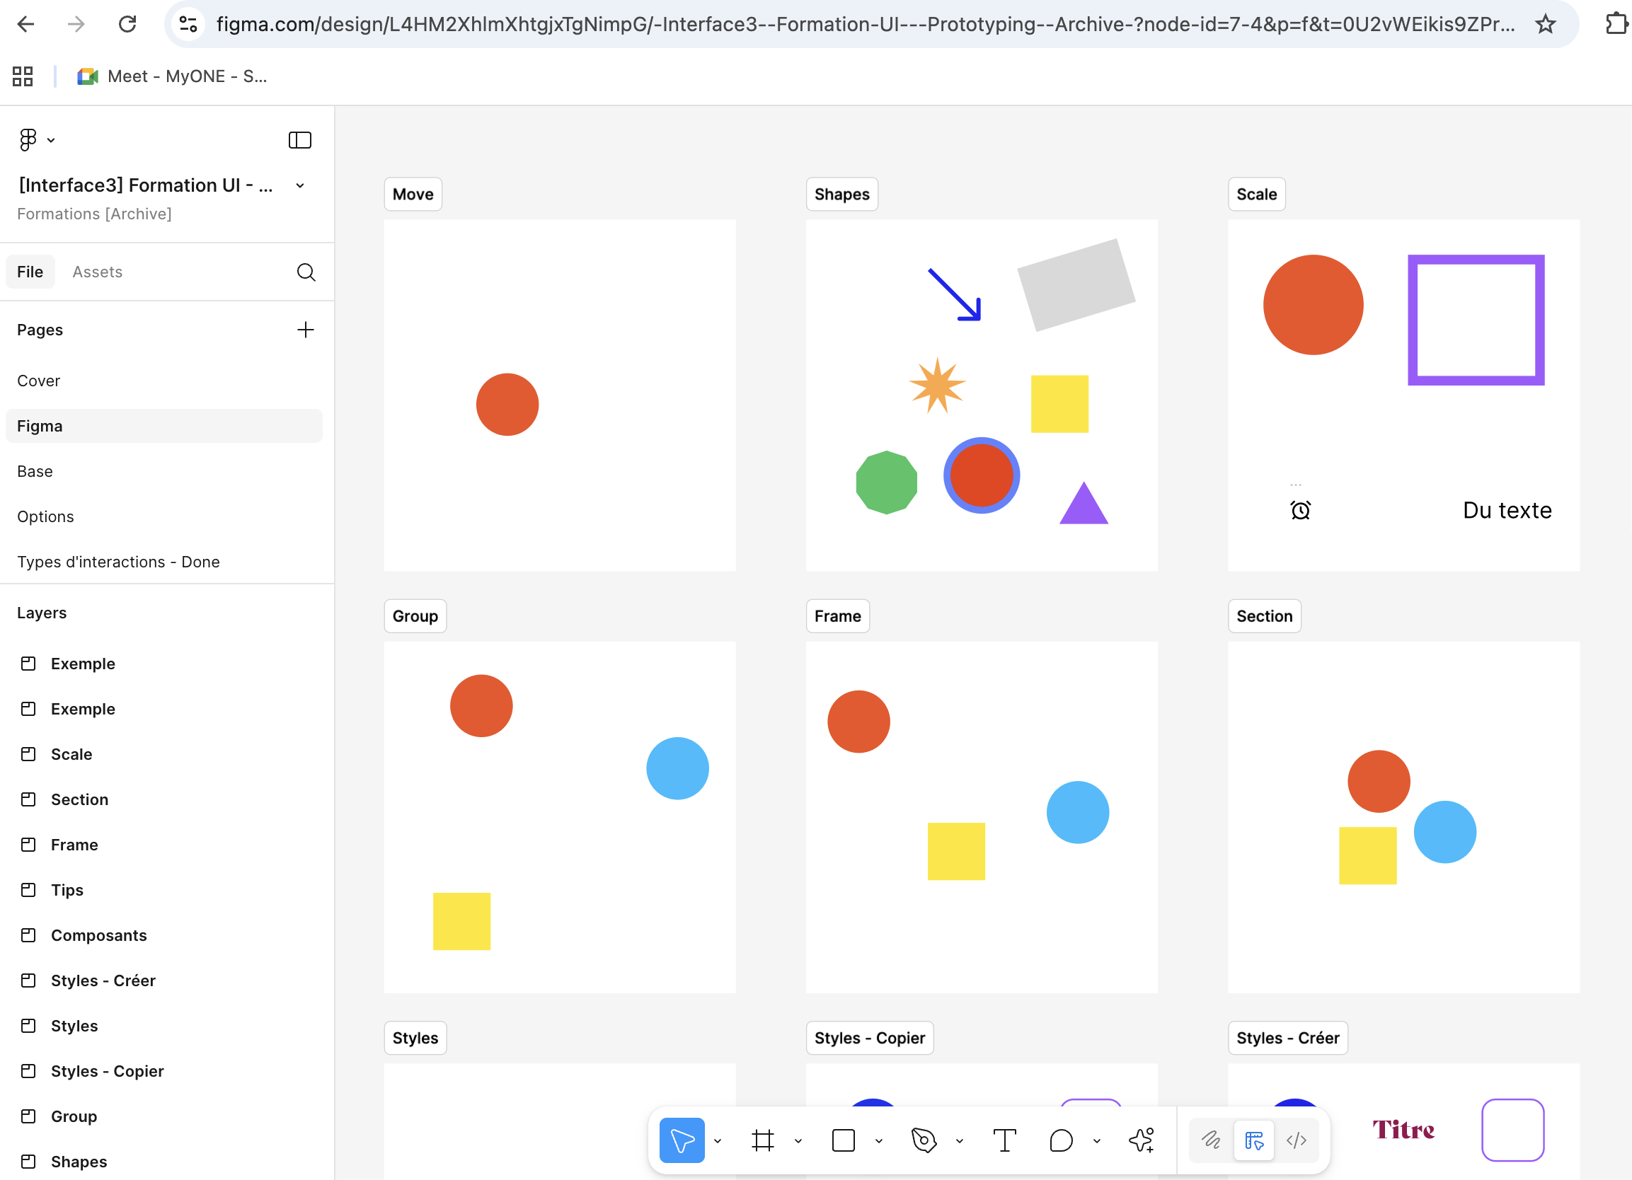
Example of an exercise : Design system & Prototyping
During this session, the goal is to get participants working in Figma as quickly as possible.
They will begin with a short introduction to the basic tools and features of Figma. Then, participants will explore the creation of components, styles, and page layouts to better understand how a Design System works in practice.
By the end of the exercise, they will have hands-on experience building and organizing UI elements that can be reused across different pages of a website.

Slide 19
User testing
User testing is one of the most critical steps in the UX process — it transforms assumptions into evidence. It allows designers to observe real users interacting with a product, uncovering what works, what doesn’t, and why.
Learning how to conduct effective user testing helps designers:
Validate design decisions with real-world feedback instead of personal opinions.
Understand user behavior and identify pain points that might not surface during interviews or workshops.
Improve usability and satisfaction, ensuring that products are intuitive and accessible.
Build empathy and keep the design process centered on human needs.
Ultimately, user testing bridges the gap between design intent and user reality, making it a cornerstone skill for any UX professional.

Slide 20
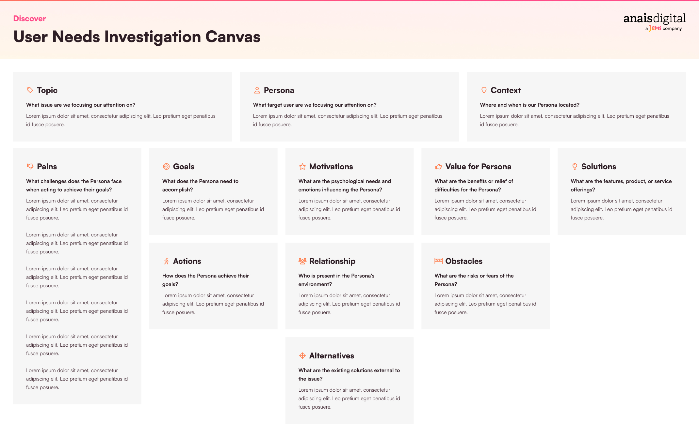
Example of an exercise : User testing
During this session, participants will learn how to plan and conduct user testing to validate design decisions.
They will start by watching a few short videos that illustrate the testing process, good practices, and common mistakes.
The User Need Investigation Canvas, to define what to test and why.
A Test Protocol Canvas, to structure their user test scenario and questions.
By the end of the session, participants will understand how to prepare, conduct, and analyze a user test, turning feedback into actionable design improvements.

Slide 21
Design thinking
Design Thinking is a human-centered approach to innovation that helps teams solve complex problems by focusing on the real needs of users. Rather than jumping straight to solutions, it encourages exploration, experimentation, and collaboration to design products and services that truly make sense for people.
In this module, participants will learn how to:
Empathize with users to uncover genuine needs and motivations.
Define and reframe problems to focus on the right challenges.
Generate creative ideas through structured ideation techniques.
Prototype and test solutions quickly to learn and iterate efficiently.
By mastering Design Thinking, participants develop a problem-solving mindset that fosters innovation, teamwork, and continuous improvement — essential skills for any modern organization.

Slide 22
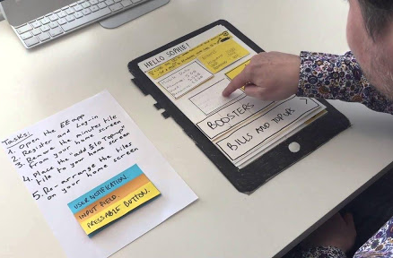
Example of an exercise : Design thinking
The Wallet project :
The Wallet Project is a hands-on, creative exercise designed to help participants apply the Design Thinking process from empathy to prototyping.
0) Create an idea by themself (without user) Participants will do a "fake start" draw idea without user to understand the difference with a UX process
Empathize – Understand the User Participants interview a peer to discover their habits, needs, and frustrations around how they “keep and use” their wallet.

Slide 23
Example of an exercise : Design thinking
The Wallet project :
2) Define – Frame the Problem Based on insights from the interview, participants summarize what they’ve learned and define a clear problem statement (“How might we help…?”).
3) Ideate – Generate Creative Solutions Through brainstorming and sketching, each participant proposes several ideas that respond to the identified need.
4) Prototype – Make It Tangible Participants quickly build a low-fidelity prototype (using paper, materials, or digital tools) to visualize and test their idea.
5) Test – Gather Feedback Participants present their prototype to their partner (the original “user”) and collect feedback to validate, refine, or pivot their concept.

Slide 24
Accessibility
Accessibility is about ensuring that everyone can use digital products and services, regardless of their abilities, context, or limitations. Learning accessibility means designing with empathy — creating inclusive experiences that work for all users, not just the average ones.
In this module, participants will learn how to:
Understand the principles of inclusive design and the diversity of user needs.
Apply accessibility standards (WCAG) to interfaces, content, and interactions.
Identify and fix common accessibility issues through audits and user testing.
Advocate for accessibility within design and development teams.

Slide 25
Metrics
Metrics and analytics give designers the power to measure the real impact of their work. They turn qualitative insights into quantifiable evidence, helping teams make informed decisions and continuously improve the user experience.
In this module, participants will learn how to:
Define meaningful UX metrics aligned with business and user goals (e.g., the HEART framework by Google).
Collect and interpret behavioral data from analytics tools to identify trends and pain points.
Link data with design decisions to validate improvements and guide iterations.
Communicate insights effectively to stakeholders and support a data-informed culture.

Slide 26
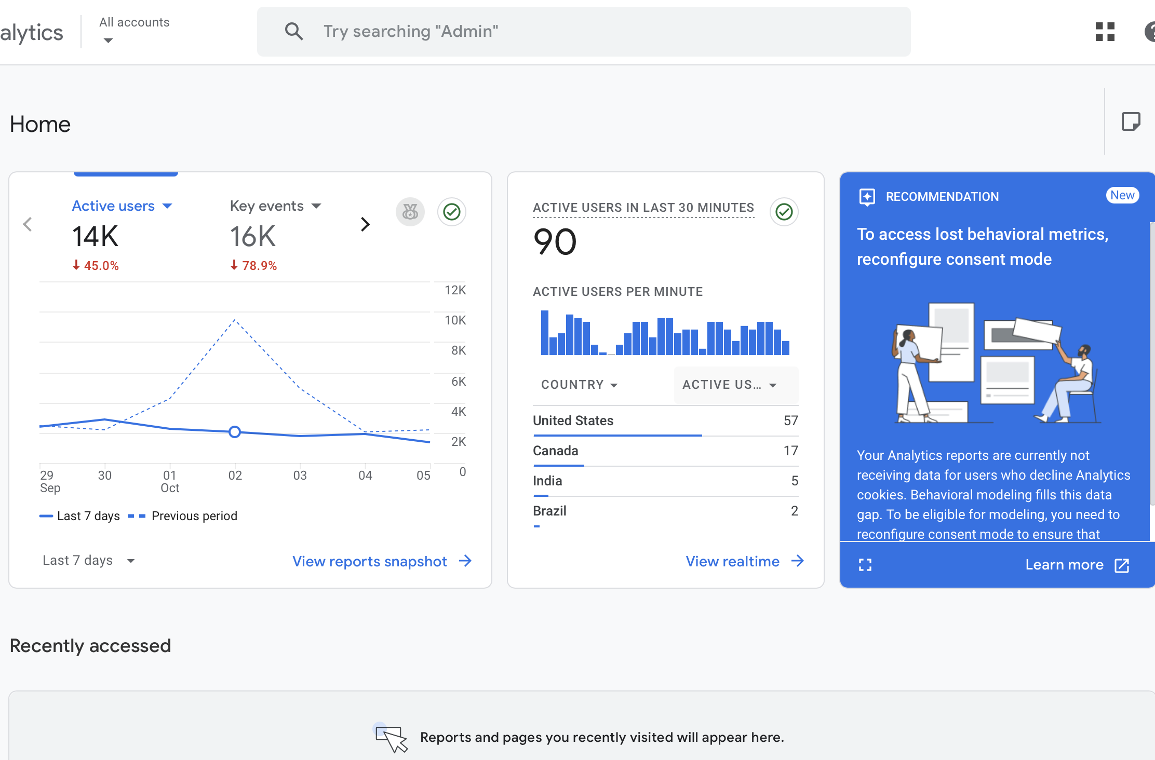
Example of an exercise : Metrics
The dashbord discovery :
We will ask participants to connect to a Google Analytics demo dashboard and try to find key metrics.
🔗 Google Analytics Demo Account
For example, participants will explore questions such as:
Where are the main users located?
What are they buying?
How did they arrive on the website?
Where do they click?

Slide 27
Project
Objectives – Realize individually a final deliverable (explained in the first lesson)
Throughout all lessons, work on the aspects covered in class in order to incorporate them into the final project.

Slide 28
Project What the theme again?
CraftEase is a web application solution developed for home improvement retailers who want to enhance customer engagement directly through their website.
Our goal is to provide your store with an integrated digital service that helps manage DIY workshop registrations, promote project tutorials, and track tool/material availability in real time.
The platform is designed to be seamlessly embedded into your existing website. It is user-friendly, secure, and adaptable to your branding and customer needs. Features include personalized project recommendations, booking management, customer feedback tools, and analytics for store teams.
By offering this added-value service, your store becomes more than a point of sale — it becomes a DIY destination.

Slide 29
Project Objective
Design the interface for a web application dedicated to home improvement retailers who want to boost customer engagement through their website.
This integrated solution will allow users to:
Register for DIY workshops
Browse project tutorials
Check real-time tool and material availability
The platform must be embeddable into existing websites, fully customizable, user-friendly, and secure.

Slide 30
Project Expected Deliverable
You will create a high-fidelity interactive prototype (mobile or desktop) including the core features of CraftEase.
The result should be portfolio-ready and professionally presented.
You are expected to deliver:
A clear definition of the user problem
A brief benchmark of 3 competing solutions
One or more user personas
A user journey or key user flow
Low-fidelity and high-fidelity wireframes
An interactive prototype (Figma)
A mini design system (typography, color palette, components, icons)
A short documentation or video explaining your design decisions
A pitch or oral presentation to defend your design choices

Slide 31
Project Suggested schedule
Phase | Time | Description
1. Brief & Problem Space | 1.5 hours | Understand the brief, user needs, and business goals
2. Research & Ideation | 3 hours | Personas, user journey, benchmark
3. Wireframing (low-fi) | 2 hours | Sketch structure and layout of key screens
4. UI Design (Figma) | 9 hours | High-fidelity screens, components, design system
5. Prototyping | 3.5 hours | Interactive prototype + testing/refinements
6. Final Pitch | 1 hour | Prepare and deliver a concise oral presentation

Slide 32
Methodologies
Lecture presentations, real-world examples and case studies.
Hands-on design.
Peer critiques and feedback sessions.
How to give a feedback? Some tips

Slide 33

Q/A

